Slide 1


T4: Compiling Sequential Code for Effective Speculative Parallelization in Hardware
Victor A. Ying mark c. Jeffrey* Daniel Sanchez
ISCA 2020
*University of Toronto starting Fall 2020
Notes:
Hi, I’m Victor Ying, and I’m presenting T4: Compiling Sequential Code for Effective Speculative Parallelization in Hardware This work was done at MIT in collaboration with my advisor Prof. Daniel Sanchez,
and my colleague Mark Jeffrey, who will start as a professor at the University of Toronto this fall.

Slide 2
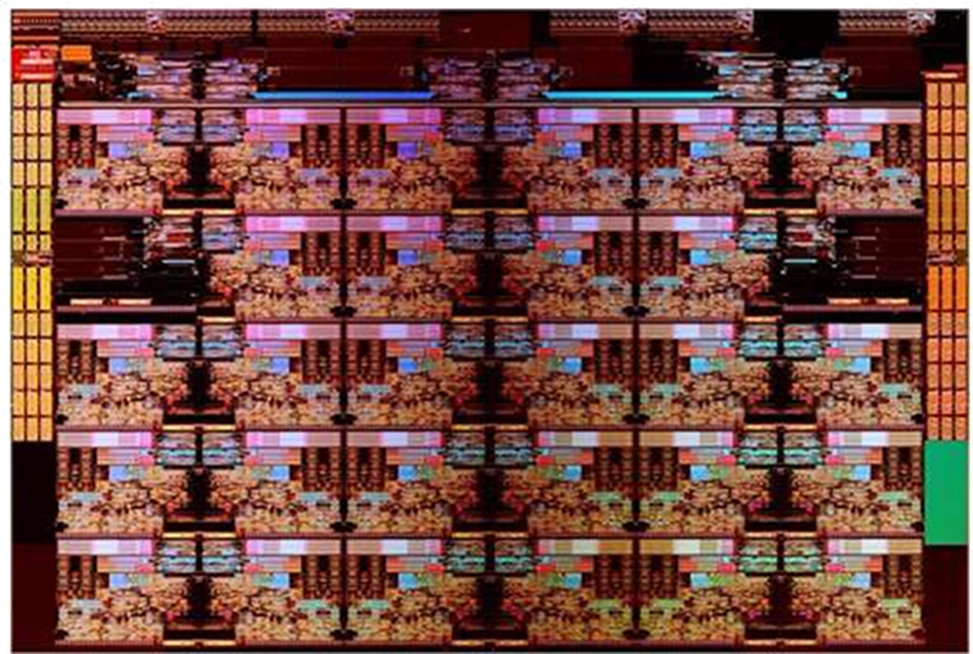
Parallelization: Gap between programmers and hardware
Multicores are everywhere
Programmers still write sequential code
…
…
…
CPU Tile
CPU Tile
CPU Tile
CPU Tile
CPU Tile
CPU Tile
IMC Tile
CPU Tile
CPU Tile
CPU Tile
CPU Tile
IMC Tile
CPU Tile
CPU Tile
CPU Tile
CPU Tile
CPU Tile
CPU Tile
CPU Tile
CPU Tile
CPU Tile
CPU Tile
CPU Tile
CPU Tile
CPU Tile
CPU Tile
CPU Tile
CPU Tile
CPU Tile
CPU Tile
Intel Skylake-SP (2017): 28 cores per die
Speculative parallelization: new architectures and compilers to parallelize sequential code without knowing what is safe to run in parallel
Notes:
We’ve all had multicore machines for years, but most programmers struggle to use multicore parallelism
[click] Programmers find it much easier to write sequential programs, which are hard to parallelize in general due to data-dependant behavior that prevents compilers from knowing what code is safe to run in parallel.
[click] To bridge the gap between sequential programs and parallel hardware, we build on recent work in speculative parallelization, which uses new architectural and compiler techniques to parallelize sequential code without knowing in advance what code is safe to run in parallel.
Die shot seems to have first been published in slide 5 here: https://newsroom.intel.com/newsroom/wp-content/uploads/sites/11/2017/09/mark-bohr-on-intels-technology-leadership.pdf
https://newsroom.intel.com/press-kits/leading-edge-intel-technology-manufacturing/#speaker-notes
I drew the labeling of tiles myself based on this: https://en.wikichip.org/wiki/File:skylake-sp_xcc_die_shot_(annotated).png

Slide 3
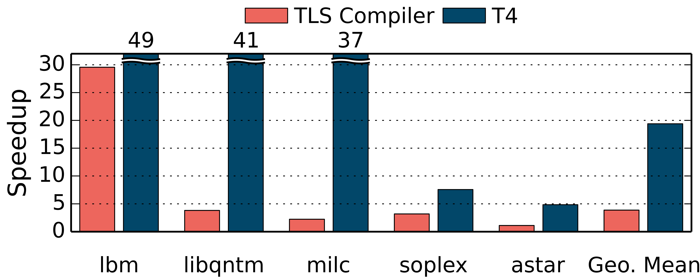

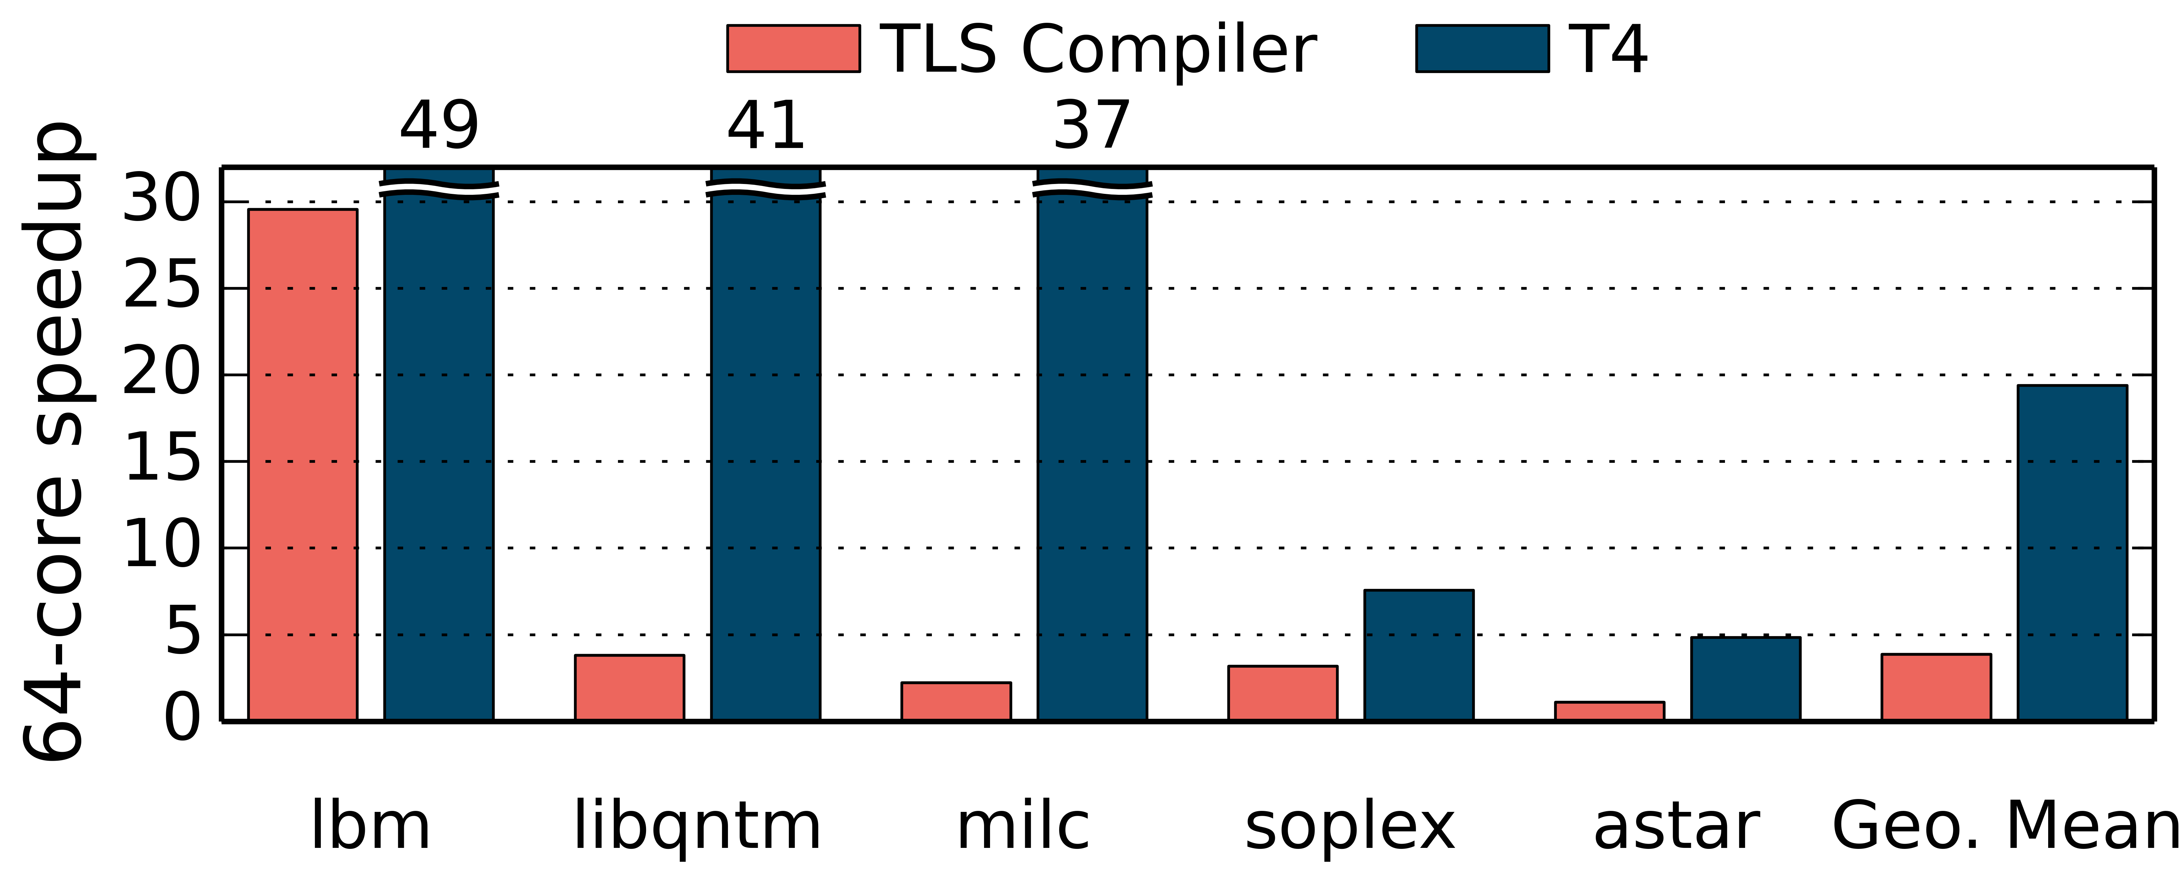
T4: Trees of Tiny Timestamped Tasks
Our T4 compiler exploits recently proposed hardware features:
Timestamps encode order, letting tasks spawn out-of-order
Trees unfold branches in parallel for high-throughput spawn
Compiler optimizations make task spawn efficient
Efficient parallel spawns allows for tiny tasks (10’s of instructions)
Tiny tasks create opportunities to reduce communication and improve locality
We target hard-to-parallelize C/C++ benchmarks from SPEC CPU2006
Modest overheads (gmean 31% on 1 core)
Speedups up to 49x on 64 cores
swarm.csail.mit.edu
Notes:
We introduce T4, an open-source compiler that exploits recently proposed hardware features to achieve effective speculative parallelization.
T4 breaks sequential code into trees of tiny timestamped tasks.
[click] T4 assigns each task a timestamp to encode sequential program order. Hardware enforces the timestamp order while allowing tasks to be spawned and run out of order.
[click] Each task may spawn multiple children out of order, forming a tree of tasks whose branches unfold in parallel for high-throughput task spawn.
[click] T4 introduces novel compiler optimizations to make these parallel task spawns highly efficient.
[click] As a result of these efficient parallel spawns, we can parallelize tasks as tiny as tens of instructions. This fine-grain parallelization creates new opportunities. For example, having tasks that touch as little as one memory location creates opportunities for T4 to schedule these tiny tasks to exploit locality.
[click] We evaluate T4 by parallelizing C and C++ benchmarks from SPEC CPU2006.
By spawning many tiny tasks, T4 imposes modest overheads to scale these real-world programs to tens of cores,
Achieving up to 49 times better performance than serial code on 64 cores.

Slide 4
Background T4 Principles in Action T4: Parallelizing Entire Programs Evaluation
Background T4 Principles in Action T4: Parallelizing Entire Programs Evaluation
Notes:
Before I tell you more about T4
[click] Let me quickly give some background on prior work in speculative parallelization

Slide 5
Thread-Level Speculation (TLS) [Multiscalar (’92-’98), Hydra (’94-’05), Superthreaded (’96), Atlas (’99), Krishnan et al. (‘98-’01), STAMPede (‘98-’08), Cintra et al. (’00, ‘02), IMT (‘03), TCC (’04), POSH (‘06), Bulk (’06), Luo et al. (’09-’13), RASP (‘11), MTX (‘10-’20), and many others]
Divide program into tasks (e.g., loop iterations or function calls)
Speculatively execute tasks in parallel
Detect dependencies at runtime and recover
Prior TLS systems did not scale many real-world programs beyond a few cores due to
Expensive aborts
Serial bottlenecks in task spawns or commits
Notes:
We have now seen a quarter of a century of work on speculative parallelization, which has often been called thread-level speculation, or TLS for short.
[click] The many groups who have worked on TLS have explored diverse architectures and implementations, but they all revolve around dividing the execution of a program into units of work that we will call tasks. These may be the iterations of a loop or calls to functions.
[click] A TLS system executes some of these tasks speculatively and in parallel, without knowing in advance if it is safe to do so.
[click] The system must therefore use some mechanism to detect dependences it has violated and then recover from them with some performance penalty.
[click] Unfortunately, as we will see, prior work in TLS performed best on a narrow class of applications where dependences are rare, and could not scale beyond a few cores given real-world programs with more frequent dependences. This is due to the expensive aborts they performed to recover from misspeculation, and serializing bottlenecks in their task spawn or commit mechanisms. Now, let me explain this using a simple example.
Daniel didn’t like calling Josep’s group “I-ACOMA”. But that group has had a series of PhD students working on TLS and most of their projects didn’t have names ☹: Venkata Krishnan (’98) who did classic early TLS-on-SMT and TLS-on-CMP work
Ye Zhang (’99) who targeted larger-scale distributed-shared-memory instead of CMP
Călin Cașcaval (‘00) wasn’t in the group but collaborated on some things for many years starting in the 90’s and up through Bulk extensions.
Marcelo Cintra (’01) who looked at scaling TLS to a hierarchical multiprocessor system consisting of multiple CMPs (this is still with lazy versioning). After graduating, he worked on predicting aborts and stalling to avoid those aborts.
Jose Martinez (‘02) who worked on speculative synchronization primatives
Milos Prvulovic (‘03) collaborated with visiting-scholar-cum-research-professor Maria Jesus Garzaran on reducing serializing bottlenecks and taxonomies of version management, eventually collaborated on extensions to Bulk
POSH was a colloaboration of the following five students led by a postdoc (Wei Liu):
Renau (’04) OoO Spawn and energy efficiency optimizations
Karin Strauss (’07) also collaborated on a lot of this work
James Tuck (‘07) collaborated with a lot of the above
Luis Ceze (‘07) Bulk, collaborated with a lot of the above
Daniel Wonsun Ahn (’12) and Xuehai Qian (‘13) developed Bulk into an implementation of sequential consistency for ordinary multithreaded code.
Other members of group further developed Bulk to provide features like data-race detection and deterministic replay.

Slide 6
TLS creates chains of tasks
Example: maximal independent set
Iterates through vertices in graph
One task per outer-loop iteration
Each tasks spawns the next
Hardware tries to run tasks in parallel
Hardware tracks memory accesses to discover data dependences
for (int v = 0; v < numVertices; v++) {
if (state[v] == UNVISITED) {
state[v] = INCLUDED;
for (int nbr : neighbors(v))
state[nbr] = EXCLUDED;
}
}
Indirect memory accesses
A
B
wr
C
rd
D
E
F
…
Time
Notes:
Let’s look at how TLS could parallelize the code shown here, which computes a maximal independent set of a graph. [click] Each iteration of the outer loop of this graph algorithm, highlighted in blue, reads and possibly updates the state of a vertex.
[click] Notice that the nested inner loop may iterate through neighboring vertices and use indirect memory references to update states of these neighbors, highlighted here in orange.
[click] We shall consider parallelizing the iterations of the outer loop, so each outer loop iteration is a task.
Here, task A will run the first iteration of the loop, but first it spawns task B, which is responsible for running the second iteration of the loop, and so on.
Notice that no more than one task is being spawned at a time.
This serial chain of task spawns was is a common feature in prior TLS systems, where the order in which tasks were spawned was coupled to their order in the original sequential program.
Now, notice that some tasks manage to run in parallel, such as task C and D, but these tasks do not necessarily perform independent computations.
Hardware must track memory accesses to discover data dependences at runtime.
[click] For example, task D may read from a location that is later written by task C. This violates a dependence on data through memory.

Slide 7
Task chains incur costly misspeculation recovery
Tasks abort if they violated data dependence
Tasks that abort must roll back their effects, including successors they spawned or forwarded data to
for (int v = 0; v < numVertices; v++) {
if (state[v] == UNVISITED) {
state[v] = INCLUDED;
for (int nbr : neighbors(v))
state[nbr] = EXCLUDED;
}
}
A
A
B
B
wr
RE-EXECUTE
C
C
rd
rd
D
D
D′
ABORT
E
E′
Unselective aborts waste a lot of work
E
F
F′
F
…
…
…
Time
Notes:
To recover, task D must abort.
When aborting task D, we must undo all of its effects, including aborting other tasks that D spawned or passed data to, such as task E and F.
[click] In general, prior TLS architectures recover from misspeculation by conservatively aborting and re-executing all later tasks across the system,
Which may often bring a significant fraction of the system to a halt. In this example, after task D aborts, all tasks D, E, and F are re-executed as tasks D’ E’ and F’.
[click] A single abort results in unselectively aborting a large number of other tasks even if those tasks, such as tasks E and F, may have actually been performing independent work.

Slide 8
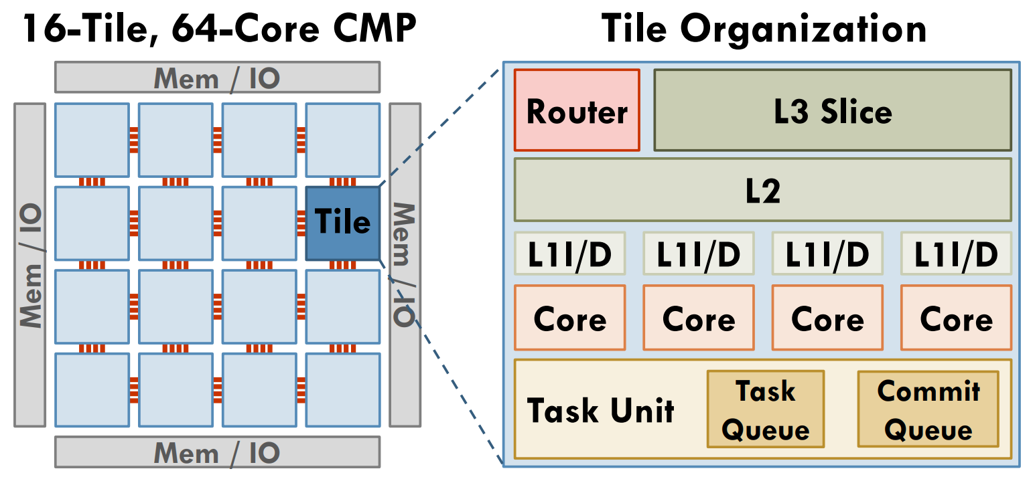
Swarm architecture [Jeffrey et al. MICRO’15, MICRO’16, MICRO’18; Subramanian et al. ISCA’17]
Execution model:
Program comprises timestamped tasks
Tasks spawn children with greater or equal timestamp
Tasks appear to run sequentially, in timestamp order
Detects order violations and selectively aborts dependent tasks
Distributed task units queue, dispatch, and commit multiple tasks per cycle
<2% area overhead
Runs hundreds of tiny speculative tasks
Notes:
To address this problem, we build on the hardware mechanisms recently proposed in the Swarm architecture.
[click] Swarm hardware exposes a task-based execution model.
Swarm programs are broken into tasks,
And each task must be tagged with a timestamp when it is spawned.
Tasks can spawn children tasks with timestamp >= their own.
Hardware guarantees that tasks appear to execute sequentially, in timestamp order.
[click] To exploit parallelism, Swarm executes many tasks speculatively and out of order on many cores.
It uses distributed mechanisms to detect order violations and recovers by selectively aborting single tasks and only the tasks that were dependent on other aborted tasks.
Swarm requires modest changes to a standard shared-memory multicore chip.
[click] Specifically, Swarm adds task queuing units, distributed throughout the chip, so that each core can spawn or execute tasks
by communicating cheaply with its nearest task unit.
These task units autonomously distribute tasks across the system,
and allow for hundreds of tiny speculative tasks to run in parallel.
Swarm has previously been used for manual parallelization of graph kernels,
but it in order to allow parallelization of entire programs,
It needs a compiler to automate the transformation of sequential code to run in parallel on Swarm.
Now note that when a task aborts, Swarm still aborts all the task’s children, so to exploit Swarm’s selective aborts we cannot construct long chains of tasks as done in prior TLS compilers.

Slide 9
Background T4 Principles in Action T4: Parallelizing Entire Programs Evaluation
Notes:
Now let see how the T4 compiler could leverage Swarm’s hardware features to improve on prior TLS work

Slide 10
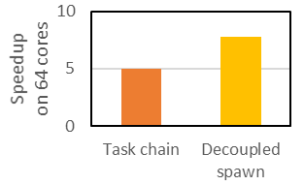
T4’s decoupled spawn enables selective aborts
T4 compiles sequential C/C++ to exploit parallelism on Swarm
Put most work into worker tasks at the leaves of the task tree
Use Swarm’s mechanisms for cheap selective aborts
for (int v = 0; v < numVertices; v++) {
if (state[v] == UNVISITED) {
state[v] = INCLUDED;
for (int nbr : neighbors(v))
state[nbr] = EXCLUDED;
}
}
A
Workers
B
C
wr
RE-EXECUTE
rd
rd
D
D′
ABORT
E
Spawners
F
…
Time
Notes:
In T4, we introduce a simple solution to the problem that aborting tasks must also abort their children:
We implement a compiler transformation that splits the work of executing loop iterations into worker tasks, separate from spawner tasks whose only job is to spawn other tasks.
Now, the majority of computation time is in the leaves of a task tree, so task D can abort and re-execute cheaply, without affecting the execution of later tasks E and F.
Simply switching from task chains to using decoupled spawners improves the parallel speedup of this example program from 5 to 8 times on a 64-core system. But with 64-cores, we can still do a lot better.

Slide 11
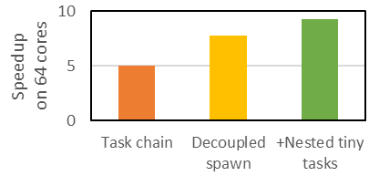
Tiny tasks make aborts cheap
Isolate contentious memory accesses into tiny tasks, to limit the damage when they abort
for (int v = 0; v < numVertices; v++) {
if (state[v] == UNVISITED) {
state[v] = INCLUDED;
for (int nbr : neighbors(v))
state[nbr] = EXCLUDED;
}
}
Tiny tasks (a few instructions) are difficult to spawn effectively
Parallelize both loops:
Parallelize outer loop only:
wr
wr
wr
wr
wr
wr
…
…
Time
Time
Notes:
So far, we have only considered parallelizing the outer loop
Consider what happens if these indirect writes in the inner loop sometimes write to the same location. This could cause an abort, and we must abort and reexecute an entire outer loop iteration.
[click] To limit the cost of aborts due to these contentious indirect memory accesses, we can isolate them into tiny tasks. To do this, we can exploit Swarm’s support for nested task spawns to parallelize both the outer loop and the inner loop,
Thus breaking down the computation into tiny tasks that are cheap to abort and reexecute.
[click] This approach does improve performance a little, but the improvement is limited when tasks are spawned in this fashion.
This is because with tasks as short as a few instructions,
the critical path becomes dominated by task spawn overheads in these chains of spawner tasks.

Slide 12
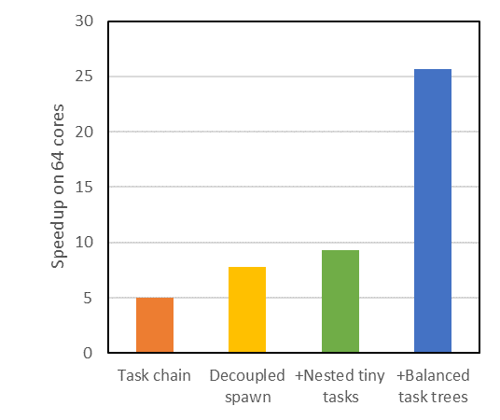
T4’s balanced task trees enable scalability
Spawners recursively divide the range of iterations
for (int v = 0; v < numVertices; v++) {
if (state[v] == UNVISITED) {
state[v] = INCLUDED;
for (int nbr : neighbors(v))
state[nbr] = EXCLUDED;
}
}
…
Workers
…
Tiny tasks (a few instructions) are difficult to spawn effectively
…
…
Spawners
Spawners
Balanced spawner trees reduce critical path length to O(log(tripcount))
Notes:
To address this problem, we can transform the spawners from a serial chain into a balanced tree, where each spawner recursively divides the range of loop iterations among its children.
[click] This asymptotically increases parallelism and enables scalability even with tiny worker tasks, by parallelizing the spawning of tasks.
Now, we can effectively parallelize this simple toy program achieving over 25x speedup.
But parallelizing entire real-world programs requires robust handling of complex code patterns

Slide 13
Background T4 Principles in Action T4: Parallelizing Entire Programs Evaluation
Notes:
Now let me tell you how T4 extracts parallelism from across large programs

Slide 14
T4: Parallelizing entire real-world programs
T4 divides the entire program into tasks starting from the first instruction of main()
T4 automatically generates tasks from
Loop iterations
Function calls
Continuations of the above
T4 extracts nested parallelism from the entire program despite
Loops with unknown tripcount
Opaque function calls
Data-dependent control flow
Arbitrary pointer manipulation
Notes:
T4 performs whole-program parallelization, dividing the entire execution of sequential programs into tasks starting from the first instruction of main
[click] T4 automatically builds nested task trees by dividing all loop iterations, function calls, and their continuations into tasks.
[click] T4’s techniques can extract parallelism in a composable way even in the presence of:
loops whose tripcount is unknown, opaque function calls, data-dependent control flow, and pointer manipulation. These common code features can defeat standard compiler analyses.

Slide 15
Progressive expansion of unknown-tripcount loops
Progressive expansion generates balanced spawner trees for loops with unknown tripcount
- loops with break statements
- while loops
6
iter(6)
iter(7)
2
10
iter(2)
iter(10)
0
iter(3)
iter(11)
4
8
iter(0)
iter(4)
iter(8)
iter(1)
iter(5)
iter(9)
Source code:
12
void iter(Timestamp i) { if (!done) {
if (!status[i]) done = 1;
else if (foo(i)) done = 1;
}
}
iter(12)
int i = 0;
while (status[i]) {
if (foo(i)) break;
i++;
}:
iter(13)
Notes:
To generate balanced spawner trees for arbitrary loops, T4 uses progressive expansion, which does not rely on static analyses to compute the loop’s trip count, or the number of iterations.
[click] For example, consider this while loop containing a break statement. It is impossible to know how many iterations it runs before it terminates.
[click,click,click] To parallelize this loop, T4 generates a progressively expanding tree of speculative spawners, in gray, with each spawner spawning a few workers, in blue, to run iterations of the loop.
To handle the control dependence of each loop iteration on previous iterations, T4 reuses Swarm’s mechanisms for data-dependence speculation to perform control speculation.
[click] To do this, T4 transforms the code as shown in this pseudocode, to use a new variable which is named “done”. T4 then transforms each task’s code to start by checking the variable to see whether to exit early, while also modifying any control flow path that would exit from the loop to set the done variable. These tasks can then be run speculatively in parallel. Whenever some iteration of the loop finally writes to the “done” variable, this quickly aborts any later iterations that should not have run.
Progressive expansion thus enables high scalability for loops that might terminate on any iteration.
Note that while I am showing only one task per loop iteration, the call to the function foo could generate nested parallel tasks within each iteration. Now let’s discuss how T4 allows nested function calls to be spawned in parallel.

Slide 16
Continuation-passing style eliminates the call stack
for (int i = 0; i < N; i++) {
float x = f();
if (x > 0.0) g(x);
}
f
f
g
f
f
g
Problem: Independent function spawns serialize on stack-frame allocation
Solution:
When needed, T4 allocates continuation closures on the heap instead
T4 optimizations ensure most tasks don’t need memory allocation
These software techniques could apply to any TLS system
Notes:
[click] Consider this loop, where each iteration, in blue calls a function f,
[click] whose return value determines whether or not to call another function g, in yellow.
[click] Ideally, we would like to spawn all the calls of f in parallel,
[click] and then, after f returns, spawn a task to call g only if needed.
[click] Conventionally, dynamic function calls require allocating stack frames, and allocating frames on a shared call stack would serialize these tasks.
[click] To address this, T4 transforms function calls that need return values into continuation-passing style, and allocates continuation closures on the heap when needed. These heap chunks can be allocated and consumed without serialization.
T4 includes further optimizations detailed in the paper to ensure most task spawns do not require any memory allocation at all.
These compiler transformations is safe for general sequential code and does not rely on any special hardware features, so it could easily be applied to any system for speculative parallelization.

Slide 17
Spatial-hint generation for locality
Tiny tasks may access only one memory location, which is known when the task is spawned.
Hardware uses these spatial hints to improve locality:
maps each address to a tile.
Send tasks for that address to that tile.
Memory controller / IO
B
A
Memory controller / IO
Memory controller / IO
0xE6823
C1
C2
Memory controller / IO
Notes:
T4’s tiny tasks create further opportunities to improve scalability.
Typical sequential programs features a lot of locality, and effective parallelization requires respecting this locality for frequently-updated data.
This is easy to do with tiny tasks that might only write to a single memory location.
T4 can generate code in a parent task to compute the address a child will write to, which serves as a spatial hint.
[click] Swarm hardware can schedule tasks with spatial hints to improve locality.
[click] For example, tasks A and B may be running in parallel on different tiles, and each may need to spawn a child that will write to some memory address.
[click] Swarm hardware can map this address to a tile, and then
[click] send tasks with a matching spatial hint to execute on this tile, avoiding ping-ponging cache invalidations when these children tasks C1 and C2 write to the same address.
But this is only possible for tiny tasks that avoid writing to many memory locations.

Slide 18
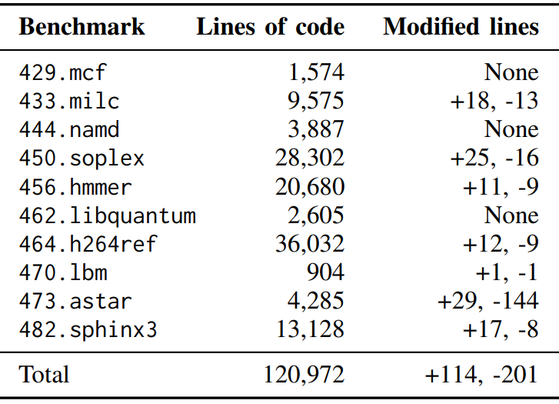
Manual annotations for task splitting
Programmer may add task boundaries for tiny tasks
Guaranteed to have no effect on program output
Added <0.1% to source code
Notes:
T4 automatically splits loop iterations and function calls into tasks, but sometimes these tasks are still too large.
[click] In some applications, we find it profitable to further split straight-line code into tiny tasks. T4 allows the programmer to annotate the code to suggest these additional task boundaries. Note that these annotations have no effects and convey no information to the compiler about program semantics, so it is always safe for a programmer to try inserting them in different positions and keep what performs the best.
[click] The table shows that we modified under 0.1% of the code in our applications, showing that T4 parallelizes the vast majority of code automatically.
We expect that future work can use heuristics to fully automate the placement of task boundaries.

Slide 19
T4 implementation in LLVM/Clang
Clang
frontend
LLVM backend
Optimizations
(e.g., -O3)
T4 Parallelization Passes
x86_64 code generation
C/C++ source code
T4 Parallelization Passes
Object file
Intraprocedural passes: small compile times (linear in code size)
Use all standard LLVM optimizations to generate high-quality code
More in the paper:
Topological sorting to generate timestamps
Bundling stack allocations to the heap with privatization
Loop task coarsening to reduce false sharing of cache lines
Case studies and sensitivity studies
Notes:
We implement T4 by modifying the popular LLVM/Clang compiler.
[click] Specifically, we add new transform passes to the LLVM backend. All our new passes are intra-procedural, that is, they act on one function at a time without requiring information on other functions. Thus, compile times stay proportional to code size.
[click] T4 is still able to benefit from all the standard optimizations in LLVM, resulting in high-quality code generation.
[click] The paper has more implementation details such as:
How T4 generates timestamps using topological sorting
How T4 bundles stack allocations into heap allocations and performs privatization
And how T4 reduces false sharing using loop task coarsening
The paper also presents case studies to detail how we break applications into tasks, and sensitivity studies to show the importance of T4’s features.

Slide 20
Background T4 Principles in Action T4: Parallelizing Entire Programs Evaluation
Notes:
Now let me show you how well T4 performs

Slide 21
Methodology
1-, 4-, 16-, and 64-core systems
C/C++ benchmarks from SPEC CPU2006
All speedups normalized to serial code compiled with clang -O3
4 4×4 mesh networks
4 MB L3 slice per 4-core tile
1 MB L2 cache per 4-core tile
32 KB L1 caches
4-wide superscalar out-of-order cores (Haswell-like)
256 entries
64 entries/tile (1024 tasks for 64-core chip)
Notes:
We evaluate T4 using cycle-level simulation
[click] of systems with up to 64 superscalar out-of-order cores.
[click] These event-driven simulations included detailed modeling of an on-chip network and a three-level cache hierarchy.
[click] Hardware task units can hold tens of speculative tasks per core, which adds up to many hundreds of tasks across the 64-core chip.
[click] We evaluate T4 on C and C++ benchmarks from SPEC CPU2006, which prior work has found difficult to parallelize.
[click] The results I will show depict the performance of T4 relative to running serial code compiled with clang –O3 on the same hardware.

Slide 22
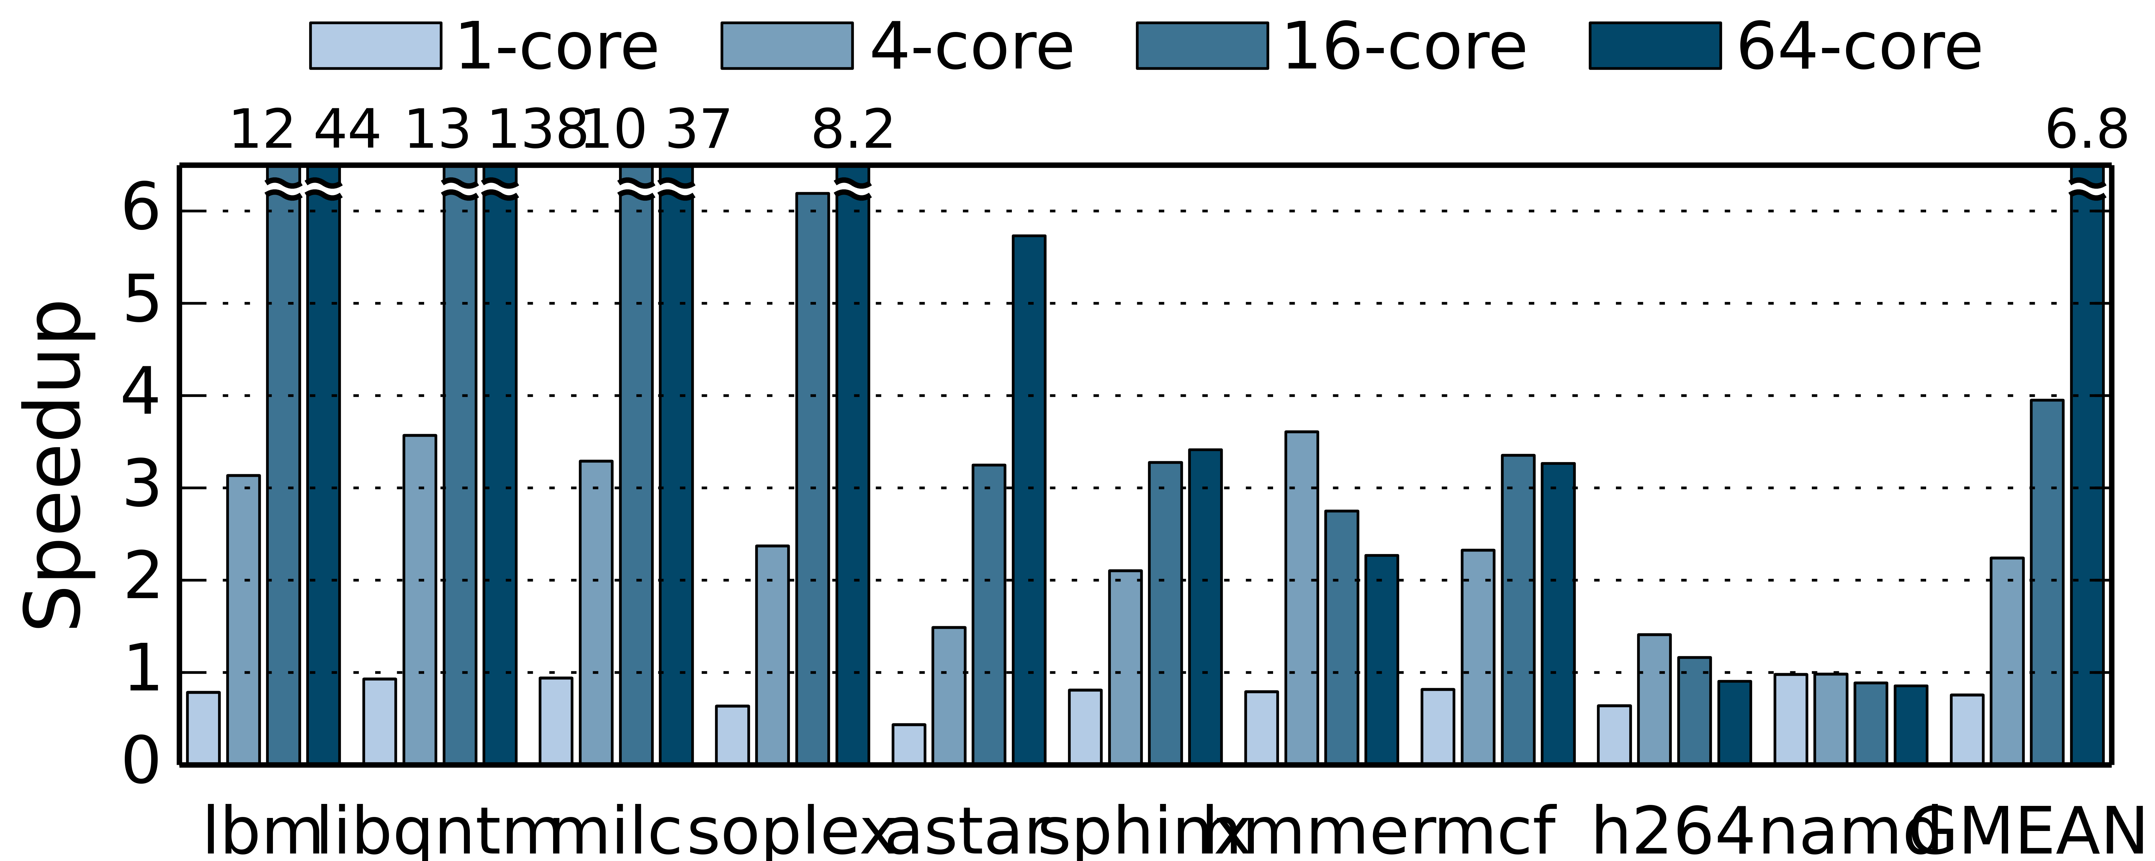
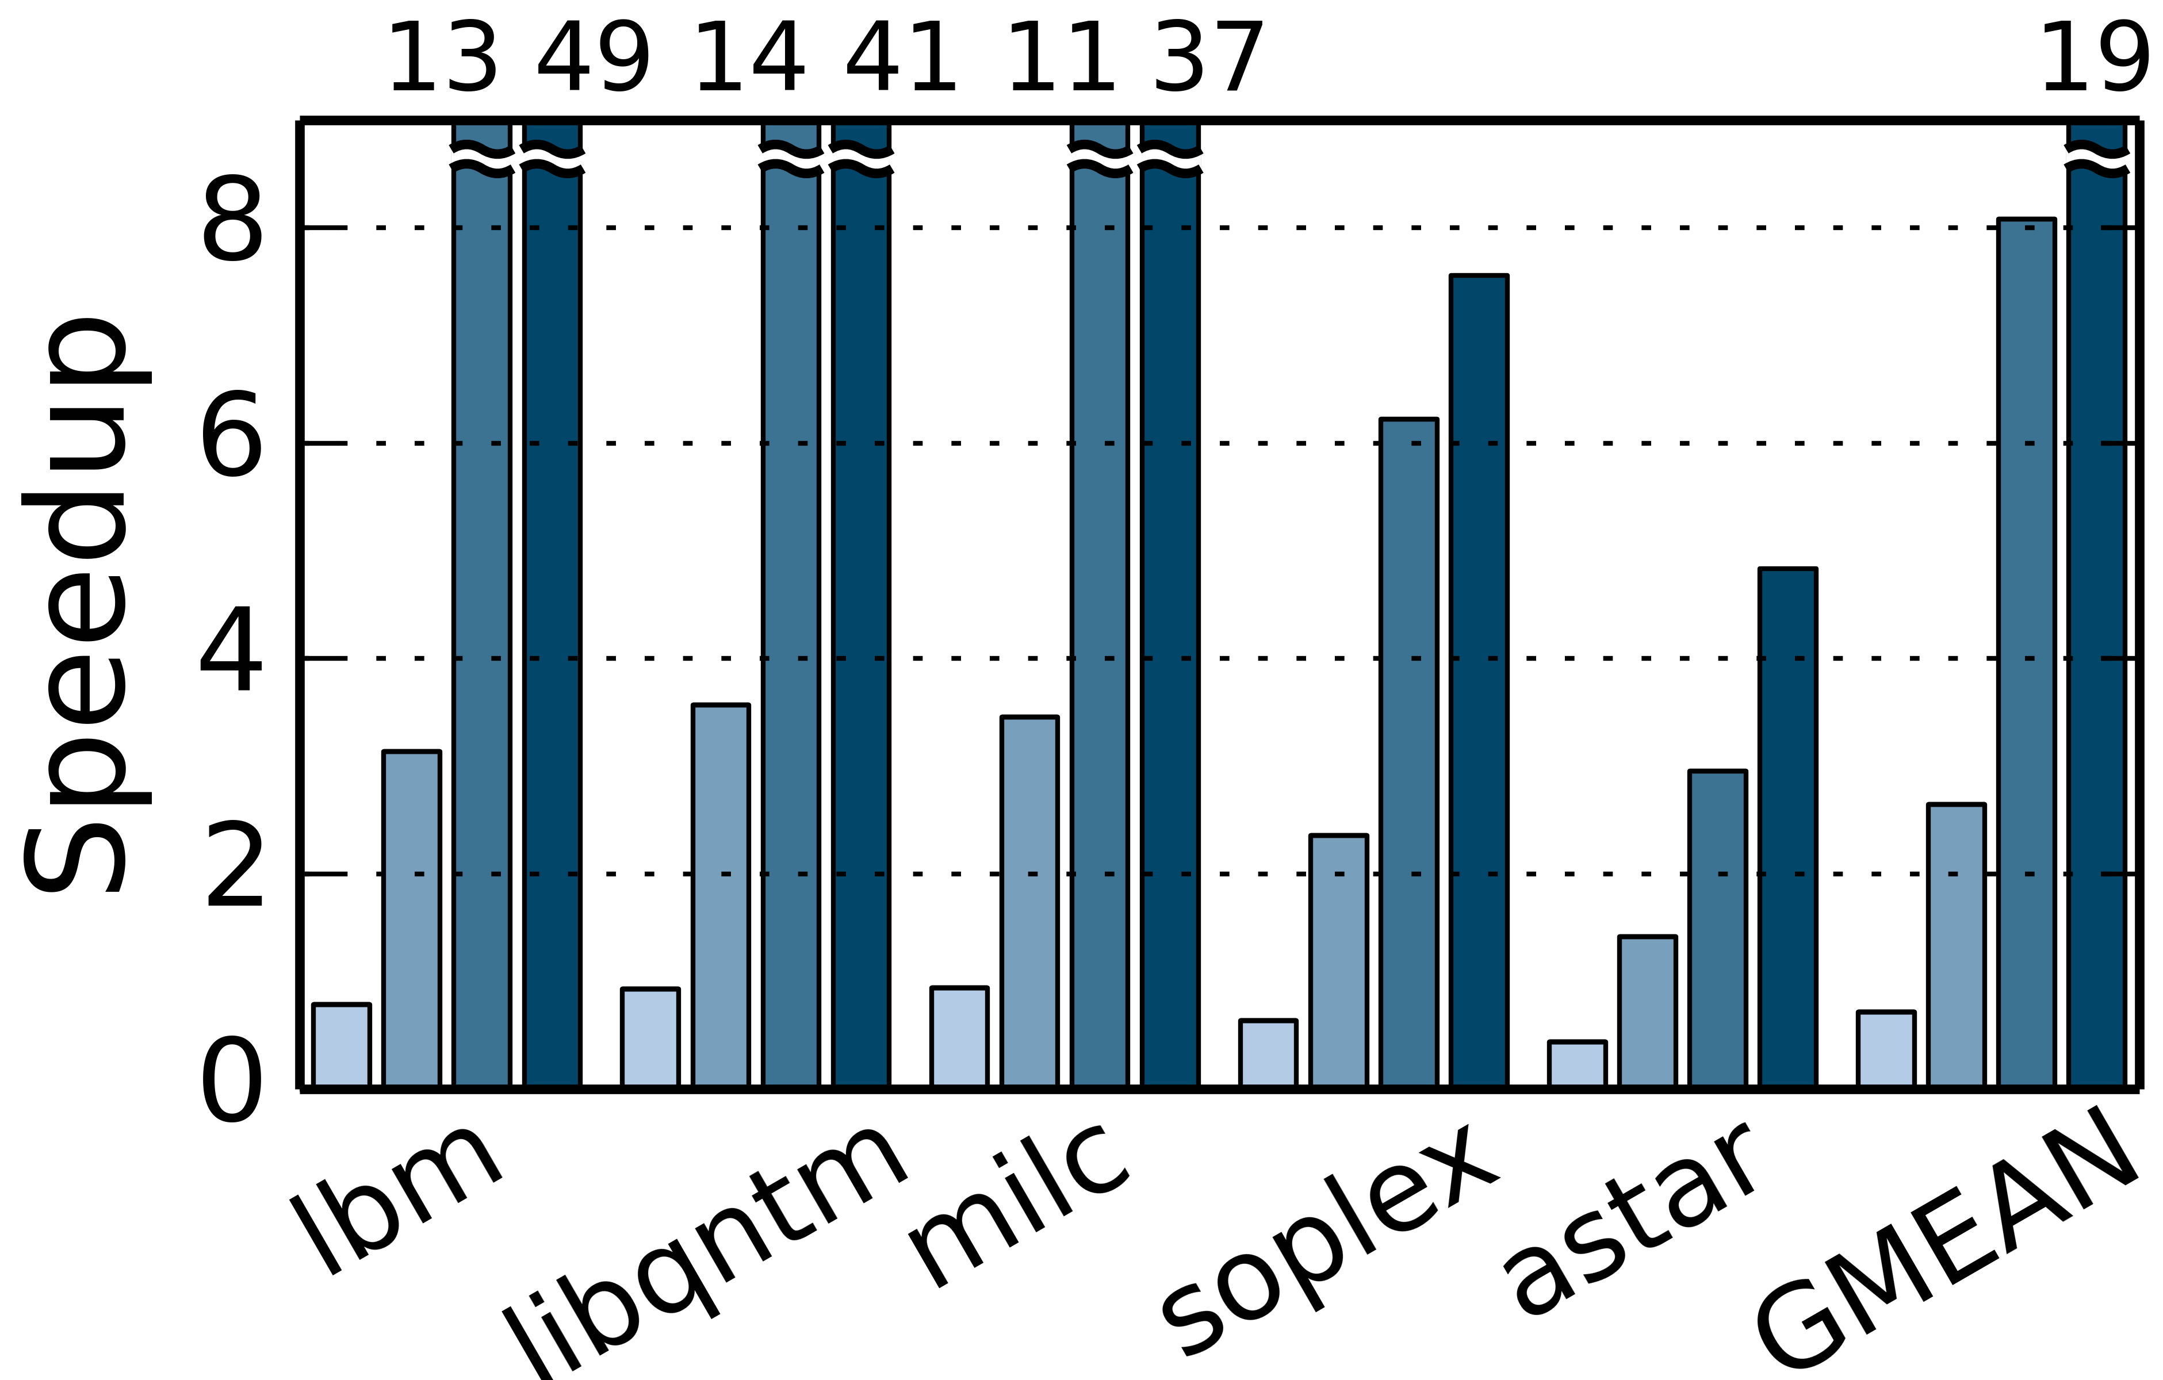
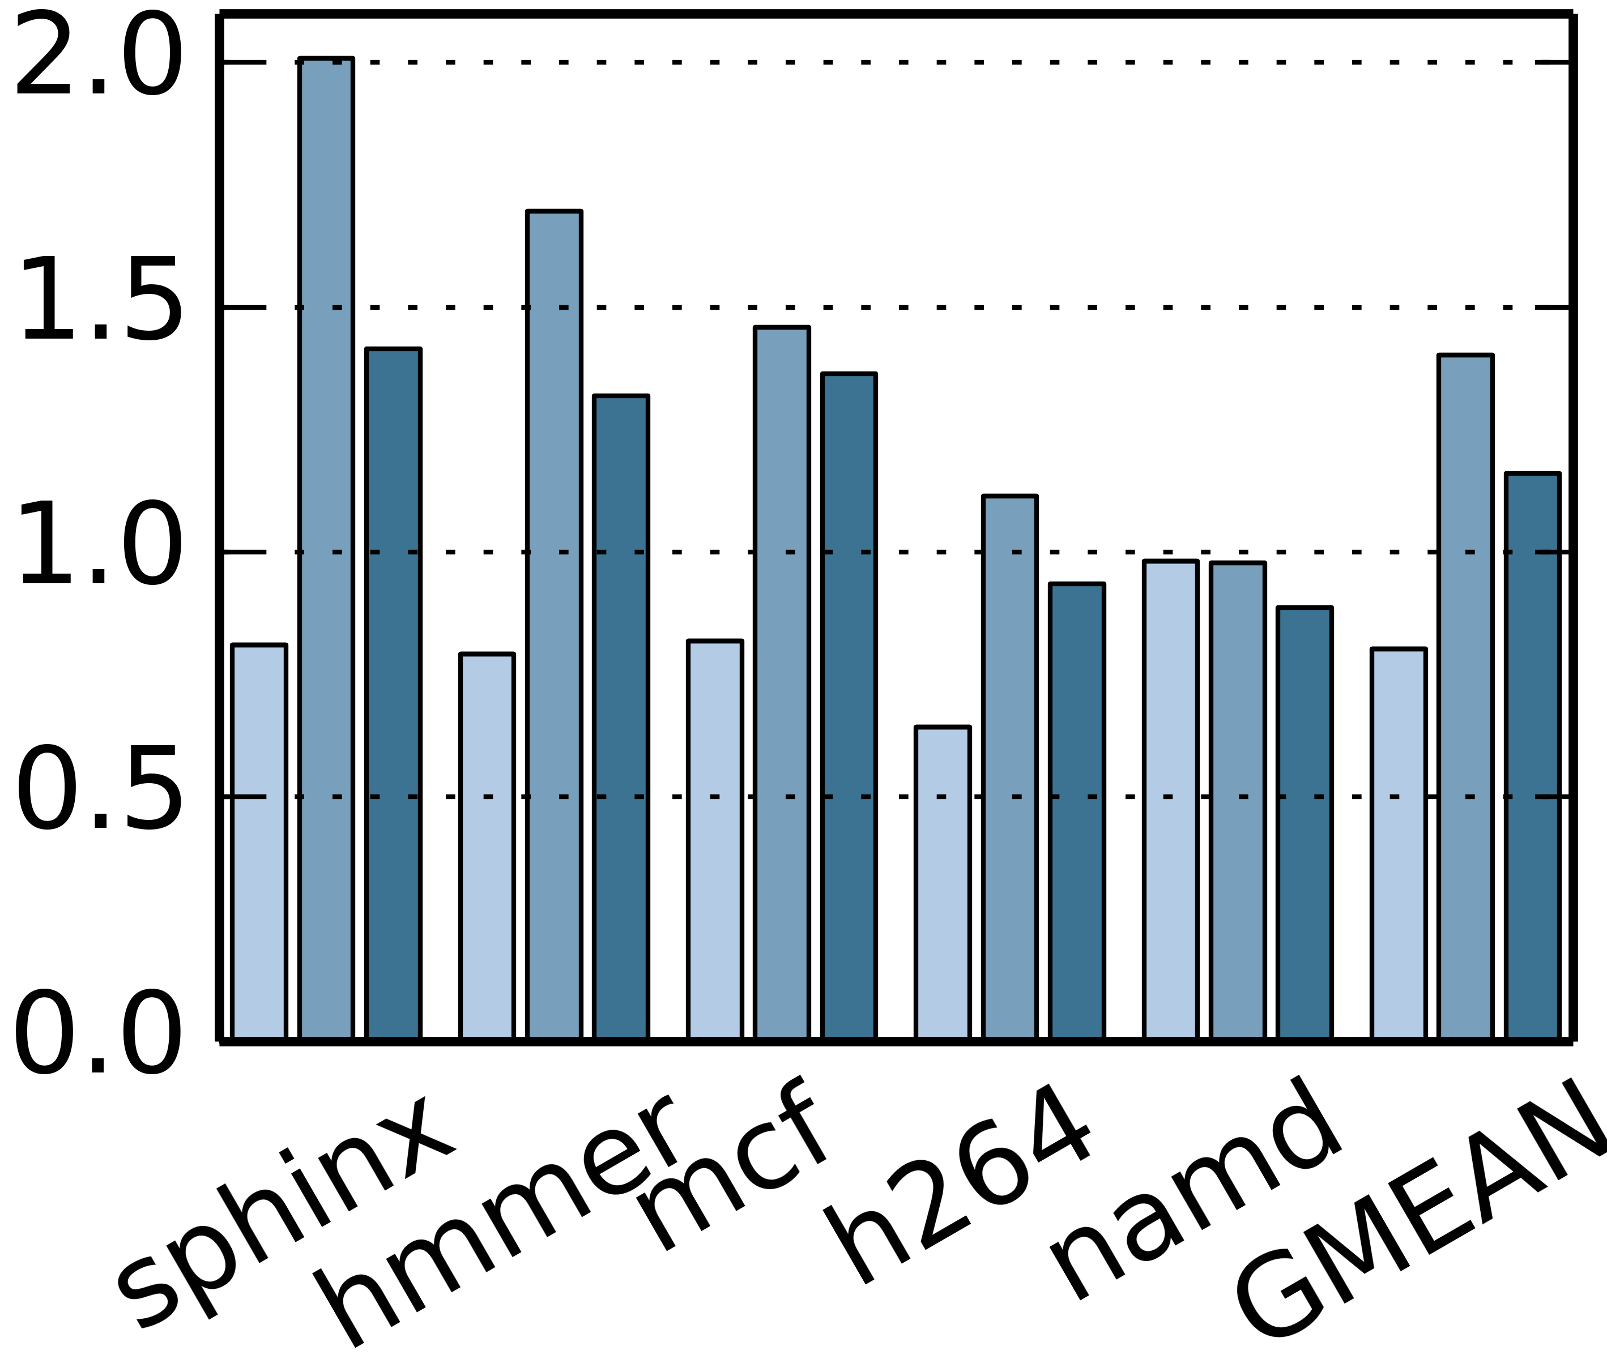
T4 scales to tens of cores
Hot loops have some independent iterations
Hot loops have serializing variables updated every iteration
Notes:
We find that scalability varies widely across applications, so we plot these applications in two groups, with different y-axis scales
On the left, we have applications who hot inner loops have at least some iterations that are independent.
T4 uncovers significant parallelism here, scaling some benchmarks linearly, so LBM achieves 49x speedup on 64 cores.
Even more impressive, T4 achieves 7x and 5x speedup on soplex and astar, respectively.
These are applications with frequent dependences where prior work struggled to even achieve 2x speedup.
On the right, we see that T4 finds more limited parallelism in some benchmarks whose hottest inner loops update a single scalar variable on every iteration.
T4 can isolate the updates to these shared variables into tiny tasks and extract parallelism from any other available computation.

Slide 23
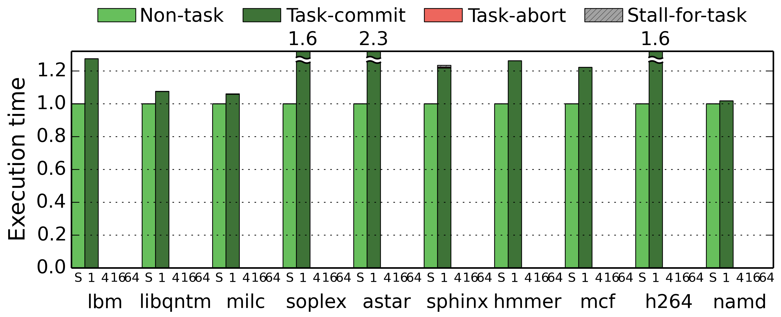
T4 overheads are moderate
Serial code, -O3 Parallelized with T4
Task-spawn overheads are geo. mean 31%
Notes:
Now, to present an alternate view of the data, I’ll show you a plot of execution time, so lower is better.
Here, we again compare the original serial code compiled with -O3, which are the light green bars, with the “parallelized” code generated by T4, which is then run on a single core.
[click] Compared to prior work, T4’s task spawns add relatively low overheads (gmean 31%) due to our efforts to ensure T4’s parallelization passes do not impede ordinary compiler optimizations.

Slide 24
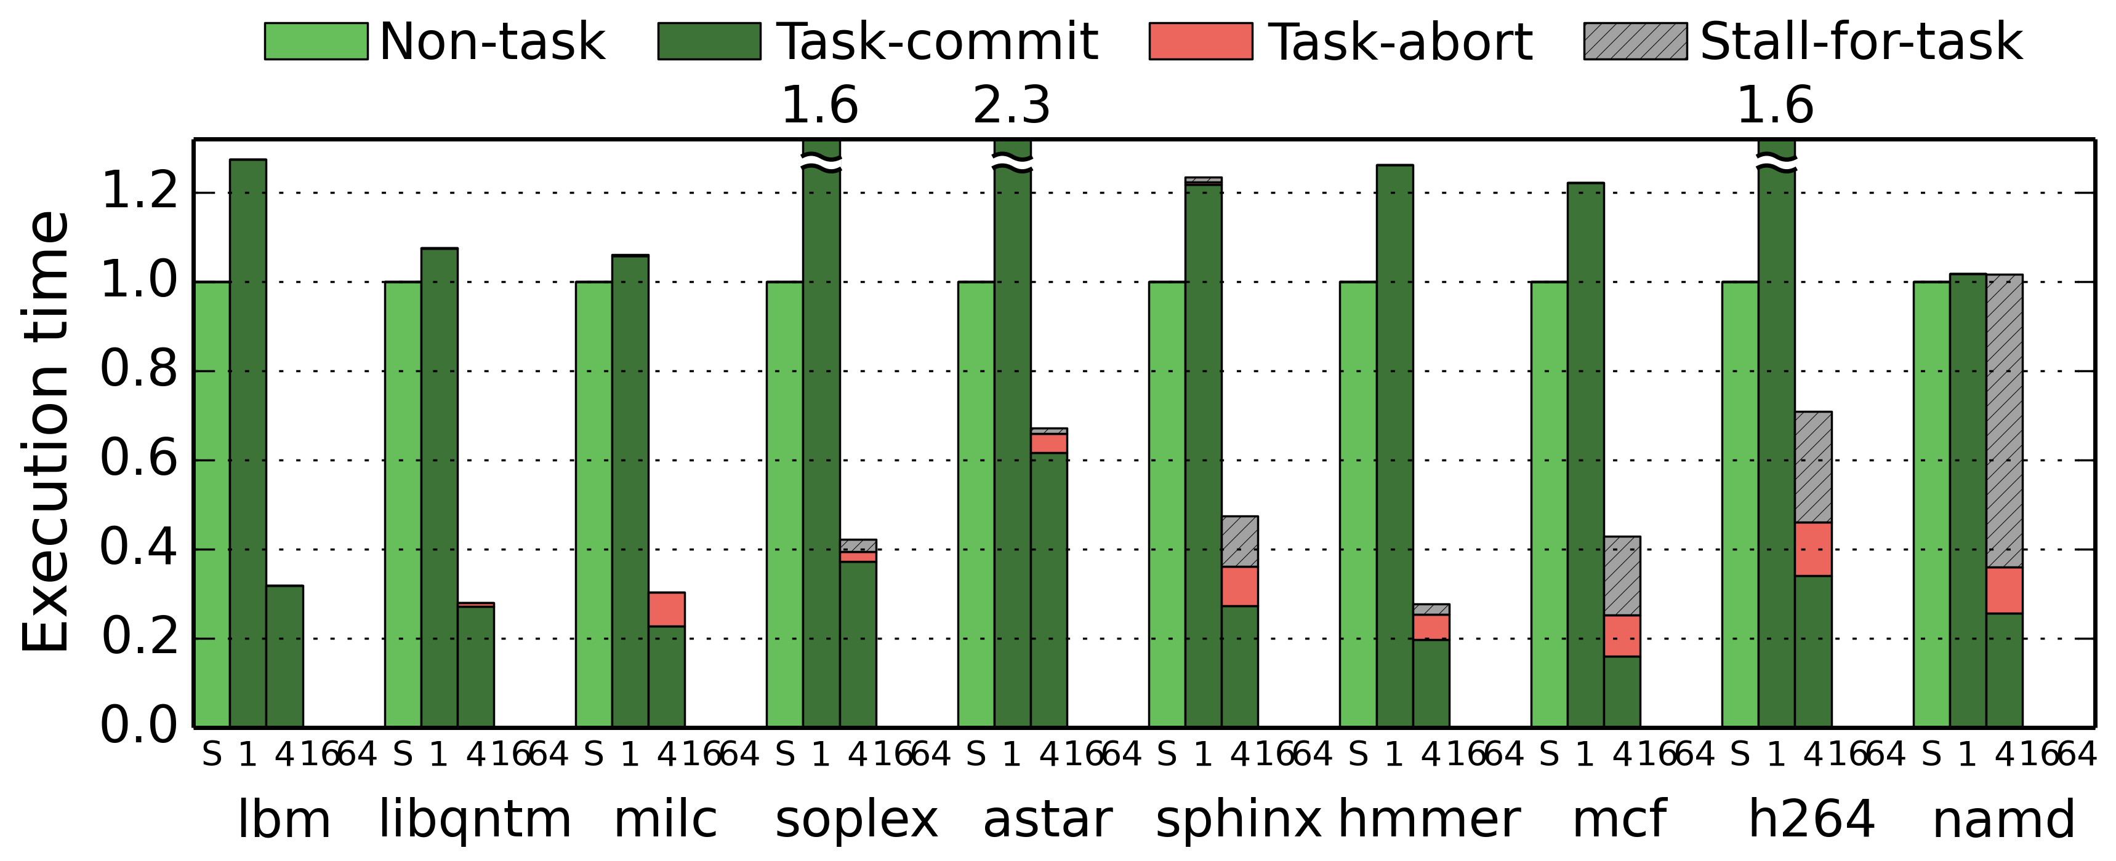
Parallelization redoubles performance
Parallel speedup
Cores spend most time executing useful work, not aborting
Notes:
Now we add the execution time of T4-parallelized code on 4 cores. T4’s parallelization more than makes up for its overheads, significantly cutting execution times on almost all benchmarks.
Within each bar, I’ve broken down execution time to how cores spend time, averaged across the 4 cores.
[click] Notice that T4-parallelized code spends most of it’s time executing useful work in tasks that commit! This stands in sharp contrast to prior work,
where inefficient task spawn or commit, or expensive mass aborts, took up most of execution time.

Slide 25
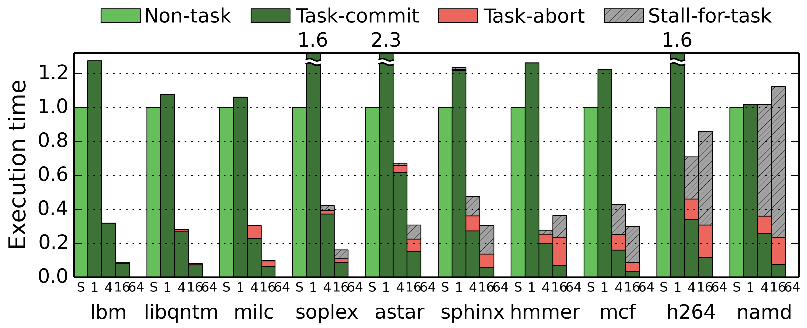
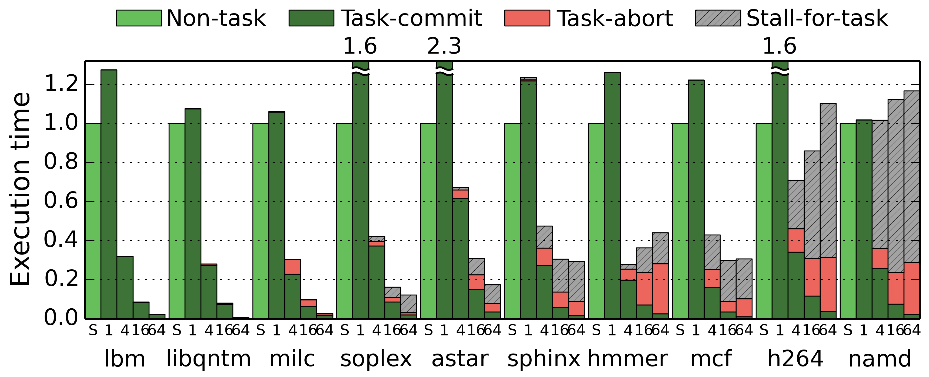
Parallelization redoubles performance
Parallel speedup
T4 scales many programs to tens of cores
Notes:
We can further look at the execution time breakdown at 16 cores [click] and then 64 cores, and see that in most benchmarks performance continue to improve.
[click] This shows T4 can make effective use of tens of cores.

Slide 26
Contributions
T4 compiler provides parallelization needed to allow sequential programmers to use multicores
T4 broadens the applications for which speculative parallelization is effective by exploiting the recent Swarm architecture
Parallelization of sequential C/C++ yields speedups of up to 49× on 64 cores
New code transformations:
Decoupled spawners enable cheap selective aborts of tiny tasks
Progressive expansion: balanced task trees for unknown-tripcount loops
Stack elimination and loop task coarsening reduce false sharing
Task spawn optimizations
Notes:
To sum up, T4 addresses the need for parallelization of sequential programs, so that programmers can more easily make use of their multicore systems.
[click] We have shown that T4 can scale difficult programs to tens of cores by exploiting the features of the recently proposed Swarm architecture. Thus, T4 broadens the range of applications where speculative parallelization is effective. We’ve evaluated T4 on challenging C and C++ benchmarks where it yielded speedups of up to 49 times on 64 cores.
[click] T4 introduces and automates novel code transformations.
T4 generates spawners that are decoupled from leaf tasks that perform the work of the application, enabling cheap aborts of tiny leaf tasks.
T4’s progressive expansion generates balanced trees of spawners to uncover asymptotically more parallelism than prior work for unknown-tripcount loops.
T4 also reduces false sharing using multiple transformations, including eliminating the call stack and coarsening loop tasks, and optimizes task spawns for high efficiency.

Slide 27
Questions?
T4 is open-source and available for you to build on:
Join online Q&A @ ISCA: First paper in Session 2B on June 1, 2020
9am in Los Angeles, Noon in New York, 6pm in Brussels, Midnight in Beijing
swarm.csail.mit.edu
Notes:
If you are interested in learning more, please come to the live online Q&A session on Monday, June 1,
Or visit our website at swarm.csail.mit.edu, where the code for T4 is publicly available for you to experiment with and build on.

Slide 28
Backup Slides

Slide 29
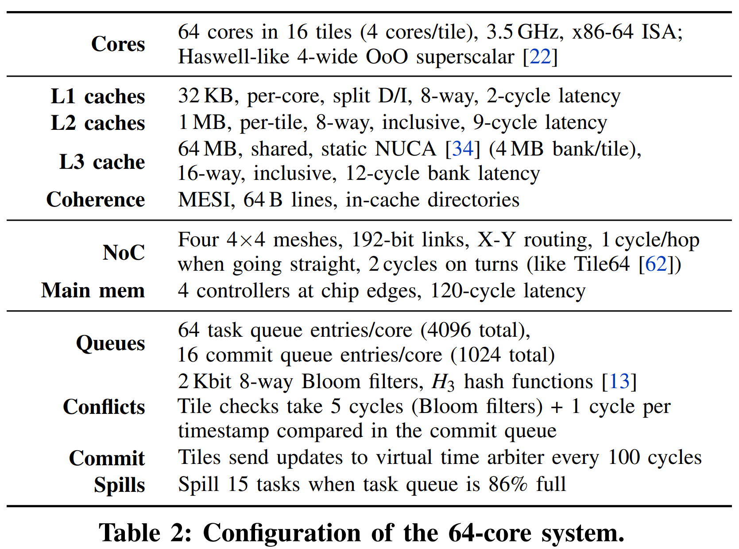
Hardware Configuration

Slide 30
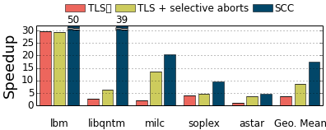
Sensitivity to spawner trees
Class A benchmarks, speedup over serial code on 64 cores.
Swarm hardware and selective aborts enable scalability
Bottleneck: One iteration spawned at a time

Slide 31
Sensitivity to spawner trees
Class A benchmarks, speedup over serial code on 64 cores.
Swarm hardware and selective aborts enable scalability
Spawner trees scale tiny tasks to tens of cores

Slide 32
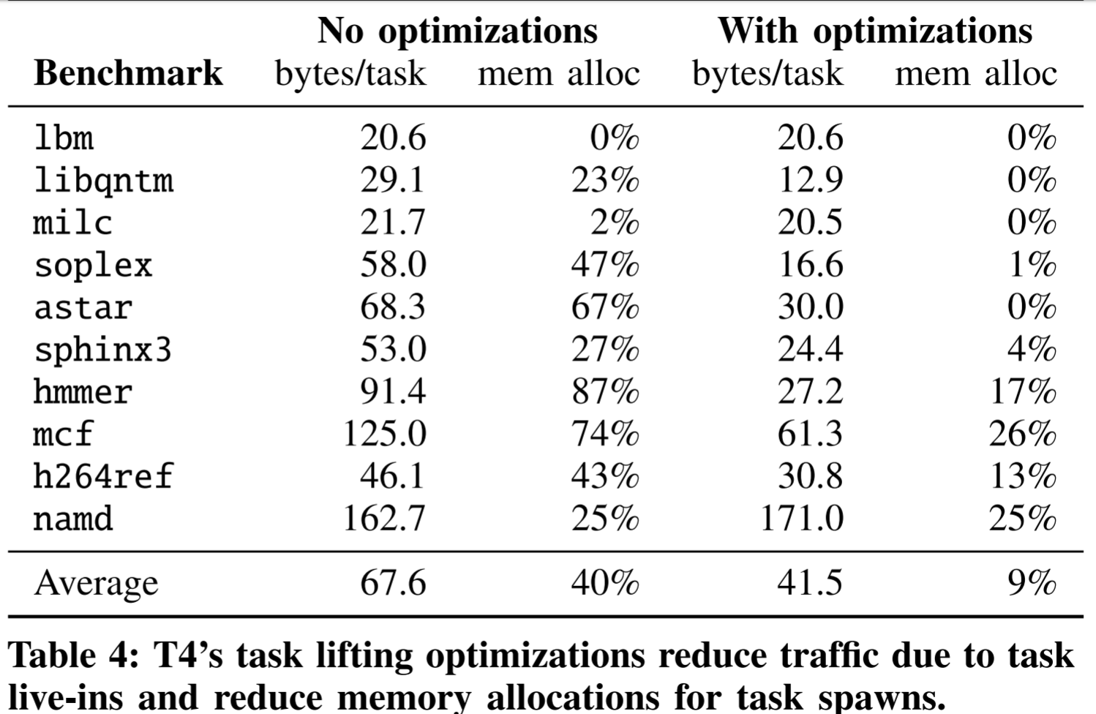
T4: Making task spawns cheap

Slide 33
Swarm architecture [Jeffrey et al. MICRO’15, MICRO’16; Subramanian et al. ISCA’17]
Execution model:
Program comprises timestamped tasks.
Tasks spawn children with greater or equal timestamp.
Tasks appear to execute in timestamp order.
Executes tasks speculatively and out of order.
Task units manage hundreds of tiny speculative tasks.
<2% area overhead.
Notes:
Swarm hardware exposes a task-based execution model.
To run on Swarm, programs must be broken into tasks,
And each task must be tagged with a timestamp when it is spawned.
Tasks can spawn children tasks with timestamp >= their own.
Hardware guarantees that tasks appear to execute sequentially, in timestamp order.
To exploit parallelism, Swarm executes many tasks speculatively and out of order on many cores.
Swarm requires modest changes to a standard shared-memory multicore chip.
We add task queuing units, distributed throughout the chip, so that each core can spawn more tasks
by communicating cheaply with its nearest task queuing unit.
(These task units autonomously distribute tasks across the system,
and can queue hundreds of tasks as short as tens of instructions each.)

Slide 34
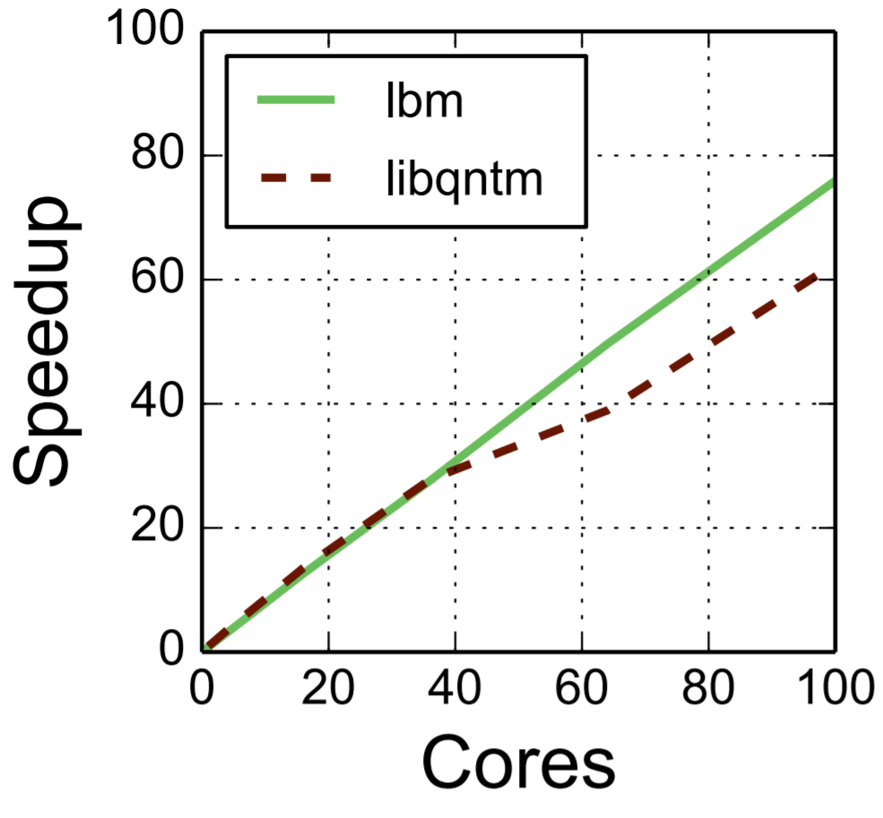
Results: T4 Scalability
Linear scalability in 462.libquantum and 470.lbm up to 100 cores!
Notes:
On these two benchmarks, we can continue to run the same code on systems with more cores, and achieve rougly linear speedup all the way to 100 cores. This demonstrates how T4’s balanced spawner trees enable distributing work efficiently, in contrast to prior speculative systems that could only scale to 4 or 8 cores.

Slide 35
Fine-Grained Task Selection
Task heuristics:
Split loop iterations
Split non-inlined function calls and their continuations.
Manual annotations suggest additional task boundaries without affecting semantics.
Ongoing work: heuristics to fully automate task selection

Slide 36
Progressive expansion: parallelizing irregular loops
Progressive expansion generates balanced spawner trees for loops with unknown tripcount.
void spawner(Timestamp i, int stride) {
if (!done) {
swarm_spawn(iter, i);
swarm_spawn(iter, i + 1);
swarm_spawn(spawner, i + stride, 2*stride);
swarm_spawn(spawner, i + 2*stride, 2*stride);
}
}
6
iter(6)
iter(7)
2
10
Source code:
iter(2)
iter(10)
0
iter(3)
iter(11)
4
8
for (i = 0; ; i++)
if (foo(i)) break;
iter(0)
iter(4)
iter(8)
iter(1)
iter(5)
iter(9)
void iter(Timestamp i) { if (!done)
if (foo(i)) done = 1;
}
12
iter(12)
iter(13)
Notes:
Prior systems cannot parallelize loops where each iteration must run to completion to determine whether to run the next iteration.

Slide 37
Hierarchical timestamps preserve program order
Must generate timestamps for arbitrary control-flow graph.
Topological sorting gives timestamps for acyclic control-flow (sub)graphs.
Targeting Fractal extension of Swarm hardware architecture [ISCA’17].
Loops, function calls handled by creating subdomains of timestamps.
Fractal hardware tracks hierarchy of timestamps, preserves apparent sequential execution.
foo(ptr)
bar()
entry:
x = load ptr
br x, then, end
entry:
br loop
TS=1
loop:
i = φ([0,entry];[inc,loop])
store arr[i], 42
inc = i + 1
br (i < N), loop, exit
then:
call bar()
br end
TS=2
TS=i
end:
store ptr, 0
ret
TS=3
exit:
ret
Notes:
Now to do all this, T4 must first preserve the program’s sequential semantics.
We do this with a general algorithm that can generate timestamps that record program order given the control-flow graph of any function.
First, consider the control flow graph of the function foo, and suppose we want to break it into three tasks: the load, the conditional call to another function bar, and a store.
A simple topological sort of this acyclic control flow graph can be used to generate unique timestamps 1, 2, and 3, that will

